Slide 1
Creating an Internship Program that Works

Slide 2
Today’s Poll
How many of you currently have or have had an intern?

Slide 3
Today’s take-aways:
Identifying the work
Designing the position
Understanding learning goals
Understanding legalities concerning pay
Marketing your internship

Slide 5
Internships – Are they worth it?
The answer to a prayer…if

Slide 6
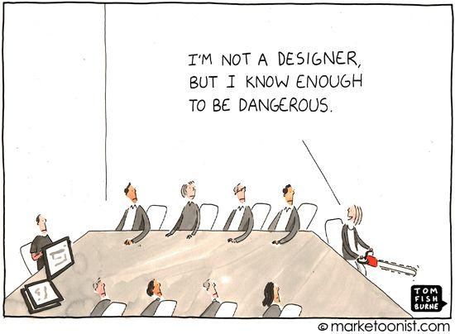
Designing an Internship
Specific focus
Expectations
Learning outcomes

Slide 7
Design
Internship-worthy work
Value to the organization
Learning experience for the intern
Notes:
Best practices
Better at the finish than at the start
We've always wanted to ___________
Expertise: Major filed of study
Application: doing what the student has learned
Results: What came about as a result of the students expertise and application?

Slide 8
Design
clear & practical reflecting learning goals
Notes:
Position description
Tasks, duties and responsibilities
Knowledge skills and abilities
Specific expectations: outcomes, hours, reporting
Clarity
No assumptions – explain clearly
No hiding – “other duties as assigned”

Slide 9
Learning Goals
Academic Credit
Assessment
Evaluation
Notes:
Academic Credit – evidence of intent to learn connected to field of study
Measure for effective completion
Academic Credit
Assessment
Evaluation
Assessment and evaluation
Assess –increase quality
Evaluate - judge

Slide 10
Learning Goals
At the completion of this internship, the student will be able to:
During the course of this internship, the student will be provided with the opportunity to:

Slide 11
4 Primary Learning Goals
Cognitive Development
Communication Skill Development
General Skill Development
Personal Development
Notes:
Handout for attendees with detail

Slide 12
Cognitive Development
Apply knowledge and skills
Connect theory to practice.
Acquire new knowledge
Integrate or synthesize knowledge
Apply higher order thinking skills to “real world” situations.
Notes:
Apply knowledge and skills related to the concepts, principles, and methodologies of one’s major or discipline and liberal arts education thereby connecting theory to practice.
Acquire new knowledge in a new setting to enhance classroom education.
Integrate or synthesize knowledge from diverse disciplines, courses and areas of experience.
Apply higher order thinking skills, such as critical thinking, analysis, synthesis, evaluation, and complex problem solving, to “real world” situations.

Slide 13
Communications Skills
Oral Communication
Written Communication
Notes:
Oral Communication:
Verbally express ideas clearly and persuasively with clients, supervisors and colleagues and to participate effectively in discussion.
Written Communication:
Express ideas clearly and persuasively in writing as evidenced by acceptable student accomplishment in at least three (3) of the following:
Student daily logs
Student/faculty or Student/supervisor email communication
Student description/rating of internship duties and supervisor
Student reports and papers
Student final report

Slide 14
General Skill Development
Specific occupation or profession
Observation, recording & interpretation skills
Diversity
Interpersonal
Networks and cultures
Effective citizenship
Leadership
Notes:
Develop skill competencies specific to an occupation or profession.
Increase skills for understanding and working with people of diverse backgrounds and cultures
Acquire additional interpersonal communication and interaction skills.
Develop skills to work effectively within formal and informal networks and work cultures.
Further develop observation, recording & interpretation skills.
Develop skills needed for effective citizenship.
Acquire skills in leadership.

Slide 15
Personal Development
Self-awareness
Clarify values
Self-reliance and self-confidence
Ethical perspective
Career awareness
Notes:
Develop self-awareness.
Clarify one's own values.
Develop self-reliance and self-confidence.
Develop and use an ethical perspective.
Develop career awareness, direction and exploration of vocation

Slide 16
Documentation
Position description
Organizational handbook
Time
Learning goals
Notes:
Learning goals
Mutual
Approved by Faculty advisor

Slide 17
Labor Regulations
Categorization of activity
For-Profit: Temporary Employment
Non – Profit: Volunteer
Academic Training Program
Exemption from comp regs
No employment relationship
Can still pay
Notes:
Categorization of activity
Label: temp employment – minimum wage, child labor, recordkeeping and overtime applies
For religious, charitable, civic, or humanitarian purposes
Volunteer time freely
No expectation of compensation

Slide 18
Criteria for Exemption
The student internship, even though it includes some actual operation of the facilities, is similar to training which would be given in an educational environment
The internship experience is for the benefit of the intern
The intern does not displace regular employees, but works under close supervision of existing staff

Slide 19
Criteria for Exemption
The employer that provides the training derives no immediate advantage from the activities of the intern; and on occasion its operations may actually be impeded;
The intern is not necessarily entitled to a job at the conclusion of the internship; and
The employer and the intern understand that the intern is not entitled to wages for the time spent in the internship.

Slide 20
2015 Internship Compensation Ruling
Fox Searchlight-Black Swan case
Labor Department’s criteria - out of date
Criteria should be more closely aligned with intern’s formal education
An employer can receive some benefit, but…
The employer cannot be the primary beneficiary of the arrangement.
More emphasis on the role of academic course work and college credit

Slide 21
Funding for Unpaid Internships
Connections Program: Saint Joseph’s College
Community Matters in Maine: Bowdoin College
Purposeful Work: Bates College
Internship Funding Program: Colby College
Center for Undergraduate Research: UMO

Slide 22
Labor Regulations
What’s wrong with these?
Internship filling in for maternity leave
Internship as a “try-out” for a permanent position

Slide 23
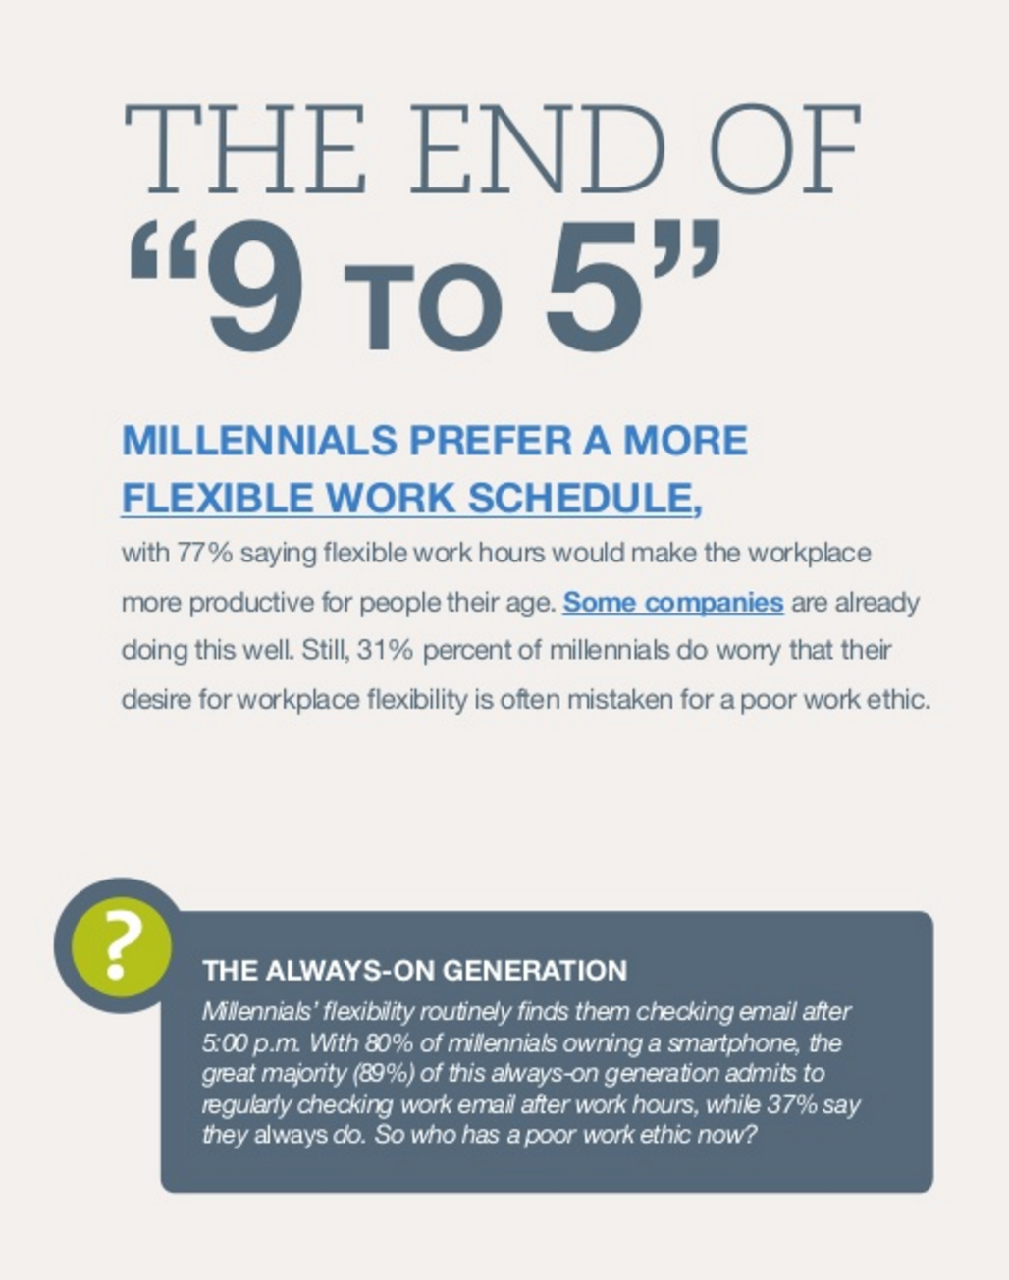
Supervision of the Millennial Generation
The line between work and personal time is an artificial boundary.
Notes:
For Millennials, the line between work and personal time is an artificial boundary.
It makes no more sense to them for you to worry about their doing personal emails and texts during “work” time than for them to worry about doing work emails and texts on their “personal” time.
There is no work time. There is no personal time. There is no work/life balance. There’s just life.

Slide 24
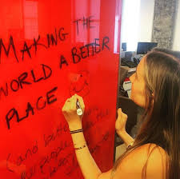
Supervision of the Millennial Generation
Work must have meaning.
Provide structure
Provide leadership and guidance
Notes:
For Millennials, work must have meaning.
They won’t commit to you or to the organization. They will commit to a meaningful, good for others cause.
Provide structure.
Reports have monthly due dates.
Jobs have fairly regular hours.
Certain activities are scheduled every day.
Meetings have agendas and minutes.
Goals are clearly stated and progress is assessed.
Define assignments and success factors.
Provide leadership and guidance.
Millennials want to look up to you, learn from you, and receive daily feedback from you.
They want “in” on the whole picture and to know the scoop.
Plan to spend a time teaching and coaching and be aware of this commitment to millennials when you hire them.

Slide 25
Supervision of the Millennial Generation
Encourage the millennial's self-assuredness, "can-do" attitude, and positive personal self-image.
Take advantage of the millennial's comfort level with teams.
Listen to the millennial employee.
Notes:
Encourage the millennial's self-assuredness, "can-do" attitude, and positive personal self-image.
Millennials are ready to take on the world. Their parents told them they can do it - they can.
Encourage - don't squash them or contain them.
Take advantage of the millennial's comfort level with teams.
Encourage them to join. They are used to working in groups and teams.
In contrast to lone-ranger attitudes of earlier generations, millennials actually believe a team can accomplish more and better - they've experienced team success.
Listen to the millennial employee.
Your millennial employees are used to loving parents who have scheduled their lives around the activities and events of their children.
These young adults have ideas and opinions, and don't take kindly to having their thoughts ignored.
After all, they had the best listening, most child-centric audience in history.

Slide 26
Supervision of the Millennial Generation
Millennial employees are multi-taskers on a scale you’ve never seen before.
Take advantage of your millennial employee’s computer, cell phone, and electronic literacy
Notes:
Millennial employees are multi-taskers on a scale you’ve never seen before.
Multiple tasks don’t phase them.
Talk on the phone while doing email and answering multiple instant messages – yes! This is a way of life
Without many different tasks and goals to pursue within the week, the millennials will likely experience boredom
What’s happening next is their mantra
Take advantage of your millennial employee’s computer, cell phone, and electronic literacy
Leverage and let them leverage the electronic tools they are so familiar with
Utilize them as trainers for others:
Google Docs? LinkedIn Recruiting? Twitter feeds? They know them all.

Slide 27
Marketing Your Internship
College Career Services
Maine College Career Consortium
Notes:
Highlight integrated learning goals
Position Description
Supervision
Expectations
Evaluation – written and oral feedback
Contact with faculty

Slide 28
Questions?
Comments?
Examples?

