Slide 1
INFRASTRUCTURE MAINTENANCE & OPERATIONAL PLANNING (AKA ASSET MANAGEMENT) Presented To: MTCMA Manager Interchange March 1, 2013 Bangor, Maine
Mandy Holway Olver, P.E.
Olver Associates Inc.
Winterport, Maine

Slide 2
The Issue:
All infrastructure deteriorates due to use and age.
Lack of maintenance accelerates the deterioration process.
Lack of resources (staff, funds) limits the maintenance that can occur.
Competing priorities prevent all needs from being addressed.

Slide 3
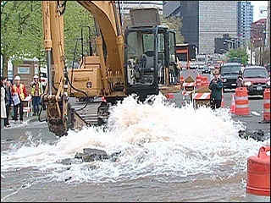
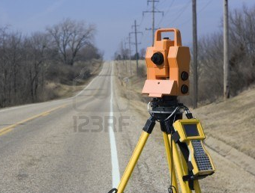
Infrastructure Planning Can Be:
Reactive or Proactive

Slide 4
Most Communities are in reactive mode by necessity
Problem Solution/Project
Water main breaks Repair it
Pothole Fill it
DEP mandates repair Fix it

Slide 5
Reactive mode most expensive:
Overtime costs
Emergency shipping/parts acquisition
Generates complaints from users/residents
Can result in fines from regulatory agencies
Reduces opportunity to request outside grant funding

Slide 6
How do you break the cycle?
Educate decision makers & public as to long term importance of planning.
Demonstrate potential cost savings.
Dedicate time or funding to create an Asset Management Plan for Infrastructure

Slide 7
Common reasons Asset Management Planning not conducted:
Our community is too small.
I have no staff to do this and not enough time.
Its going to cost too much to hire someone.
Selectmen/Council/Trustees/Commissioners will never support this effort.

Slide 8
Reality? Yes & No
Asset management will be time consuming initially, just like creating a map, but once you have it, it is really helpful tool on which way to go.

Slide 9
What is Asset Management?
Asset management can be defined as a plan for maintaining a desired level of service at the lowest life cycle costs – United States Environmental Protection Agency (EPA)

Slide 10
What the typical municipal infrastructure assets to be managed?
Anything & everything

Slide 11
What is the goal of Asset Management?
Slow down deterioration/increase service life.
Increase cost effectiveness/avoid unnecessary expenditures.
Minimize unplanned repairs or expenses.

Slide 12
Infrastructure Examples:
Sanitary Sewer System
Wastewater Treatment Facility
Water Distribution System
Water Treatment Facility
Stormwater Drainage
Roads/Sidewalks

Slide 13
Other Assets beyond this discussion:
Schools
Community Buildings
Town Office Assets
Public Works
and the list could go on…………

Slide 14
Asset Management Basics
Inventory the Asset Components
Determine Useful Life
Estimate Replacement Value
Determine funding options/available funds
Set Priorities & Schedules

Slide 15
We will focus on the following for the remainder of this discussion
Wastewater Collection System
Wastewater Treatment Plant
Water Distribution System
Water Treatment Plant
Stormwater Drainage
Roads/Sidewalks

Slide 16
Wastewater Collection System
The assets to inventory:
Sewer lines
Manholes
Pump Stations
Other items (combined sewer overflow, siphons)
The characteristics:
Pipe materials
Age (if known, or estimated)
Sizes
Combined, or sanitary only?

Slide 17
Resources:
Record drawings (which community hopefully has)
Department of Environmental Protection
Institutional knowledge
CSO master plan, if applicable

Slide 18
EPA Wastewater

Slide 19
Do it yourself inventory
Location | Sewer | Length | Manholes | Manhole Material | Year Installed | Notes
Elm Street | 8” AC | 400 | 2 | Brick | 1960 | Plugs often, leaks, repaired 2011
Pine Street | 12” PVC | 600 | 3 | Precast Concrete | 1997 | Cleaned 2007

Slide 20
Could sort by age, condition of frequency of issue.
If you are a Combined Sewer Community, may be you have a master plan that dictates a schedule already. This is most of what you need for sewers.
Pump stations categorized by age, type, repair history, and size of service area.

Slide 21
What Needs Does Each Component Have?
Flush sewers & manholes
Spot repairs of trouble areas
Repair covers & interiors of manholes especially if brick
Budget for complete replacement or separation if a combined sewer

Slide 22
Wastewater Treatment Plant
The assets are well known to your operator as equipment they maintain.
Sources of data inventory include design plans, name plate data, and operations and maintenance manuals.

Slide 23
Maintenance Program/Assets Management
Many plants have a maintenance card or computerized system to track equipment maintenance.
Inventory the equipment in plant, including laboratory and computers, list ages and replacement values, and estimate useful life.
Schedule maintenance for equipment and make sure critical items are budgeted to extend their useful life.

Slide 24
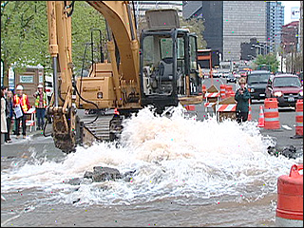
Water Distribution System
Similar to sewer in characteristics but the consequences of aging are sometimes a little more obvious.

Slide 25
Asset inventory includes
Pipe
Booster Stations
Hydrants

Slide 26
EPA Water Guideline Book

Slide 27
EPA Web Page

Slide 28
Water Treatment Plant
Similar to Wastewater Plant process
Inventory all equipment, computers
Estimate useful life
Estimate replacement costs
Create priority list of implications of failure
Budget maintenance and replacements accordingly

Slide 29
For Water & Wastewater Systems:
Considerations - will public health risks result to drinking water supply?
Will loss of service result?
Should redundant parts be on-site; do we budget and obtain these now? Or are they readily available locally?
Cooperation with other local government entities – shared spare parts and backup operations support.

Slide 30
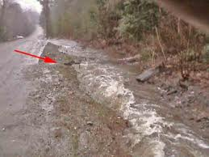
Stormwater Collection – The Forgotten Utility
Usually the lowest priority, but can create some significant issues.

Slide 31
Why is stormwater often forgotten?
No specific regulatory agency
Little or no grant funding options
Spot repairs addressed on emergency basis
System tends to evolve as issues occur

Slide 32
The inventory assets
Pipe
Catchbasins/Manholes
Ditches
Detention Structures

Slide 33
Stormwater items need attention too
Same process as for other pipe:
Size
Material
Age
Stability of erosion areas
Impact on public safety & access
Design basis/adequacy?

Slide 34
Stormwater Maintenance
Reditching saves roads as well as conveying water.
Clear blocked culvert entrances/add rip rap.
Vactor catchbasins and clean pipes on a rotating basis.

Slide 35
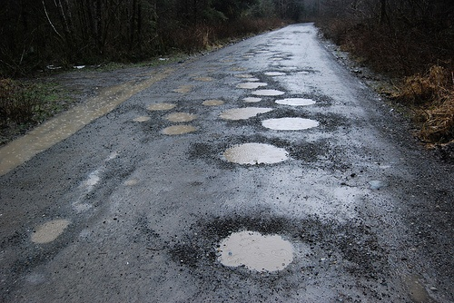
Roads & Sidewalks
Everyone in the community is an expert on this one.

Slide 36
Road Asset Management Principles
Inventory of Roads
Length
Surface
Year last maintained
Overlay
Reconstruction
Ditching
Repairs
*where are we spending our public works or contractor time/money?

Slide 37
What is under the pavement?
Worst – native soils – highly subject to frost action.
Better – gravel with no drainage – can still freeze and be damaged.
Best – gravel with ditches and or underdrain, adequate drainage.

Slide 38
How about configuration?
Most roads were not designed, they evolved.
Are the intersections safe?
Are the roads wide enough?
Is drainage adequate?
Site distance, slopes, cross section, signage, lighting, signals.
Obstacles along the sides of the road?

Slide 39
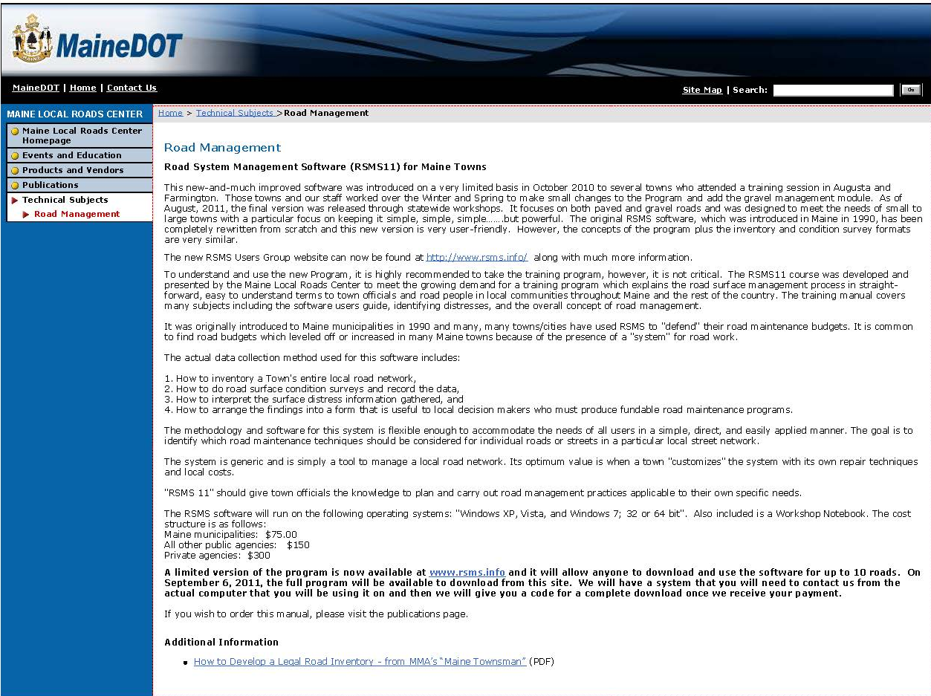
Asset Management for Roads
MDOT Road Surface Management Software System
www.maine.gov/mdot/csd/mlrc/technical/roadmgmt.htm www.rsms.info

Slide 40
Is A Complete Inventory of Assets Too Much Work?
Simplify – do the minimum to get started this will still help decision making on priorities.
Examples:
For each system – list the ten worst areas & prioritize them.
Where are the maintenance headaches?
Where are the health, safety and regulatory risks?

Slide 41
Resources to Assist
Technical Assistance
Maine Department of Environmental Protection
Maine Department of Health & Human Services – Drinking Water Program
Maine Department of Transportation – Local Roads Program
Engineering Consultants

Slide 42
Resources to Assist
Funding
State Revolving Loan Fund
CWSRF
DWSRF
Local Bonds
Department of Economic & Community Development
Community Development Block Grant/Planning Grant
USDA – Rural Development Rural Utilities Program

Slide 43
Asset Management Summary
Concepts are relatively simple, but implementation can be daunting.
Don’t be intimidated by the details – use estimates, institutional knowledge, and start somewhere.
Work up to fully integrated plan for your community. Coordinate schedules for utilities & roads.
Bring in outside assistance if necessary.

